Slide 1
TEST KIT & BASIC PROGRAMMING

Slide 2
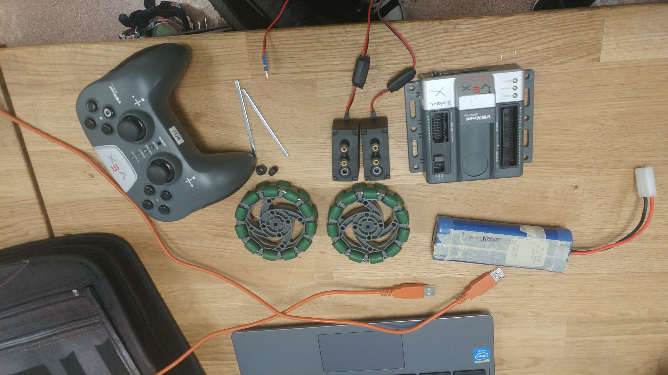
Here are all the materials you need:
2 motors
2 shafts (3’’)
2 rubber collars
2 omni wheels (or any wheels)
1 VEX cortex
1 battery
1 A-to-A cable
1 laptop for programming

Slide 3
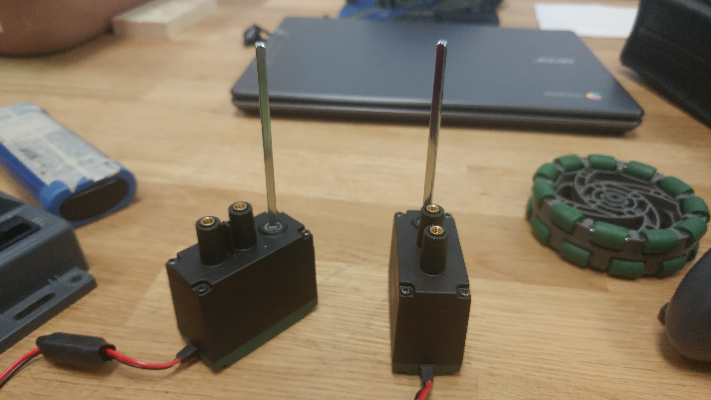
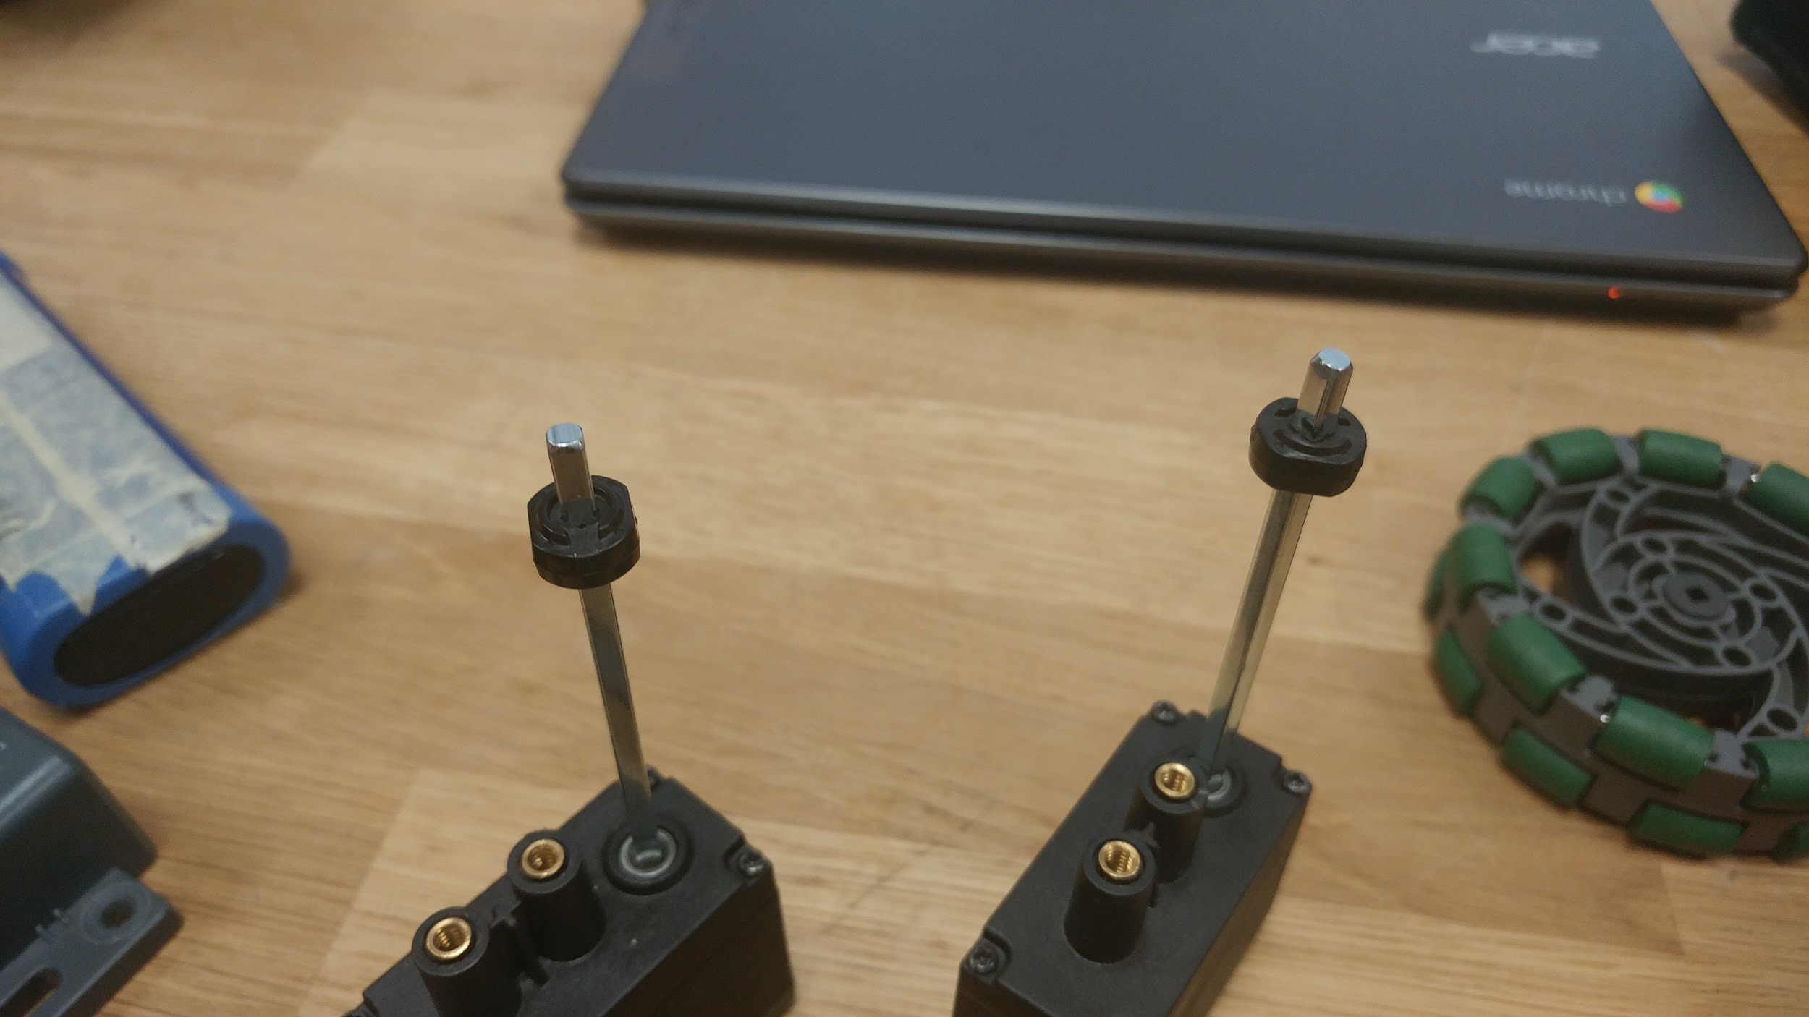
Step 1:
Put the shafts in the motors.
Step 2:
Slide the rubber collar on the shafts. The position of the collar can be adjusted later.

Slide 4
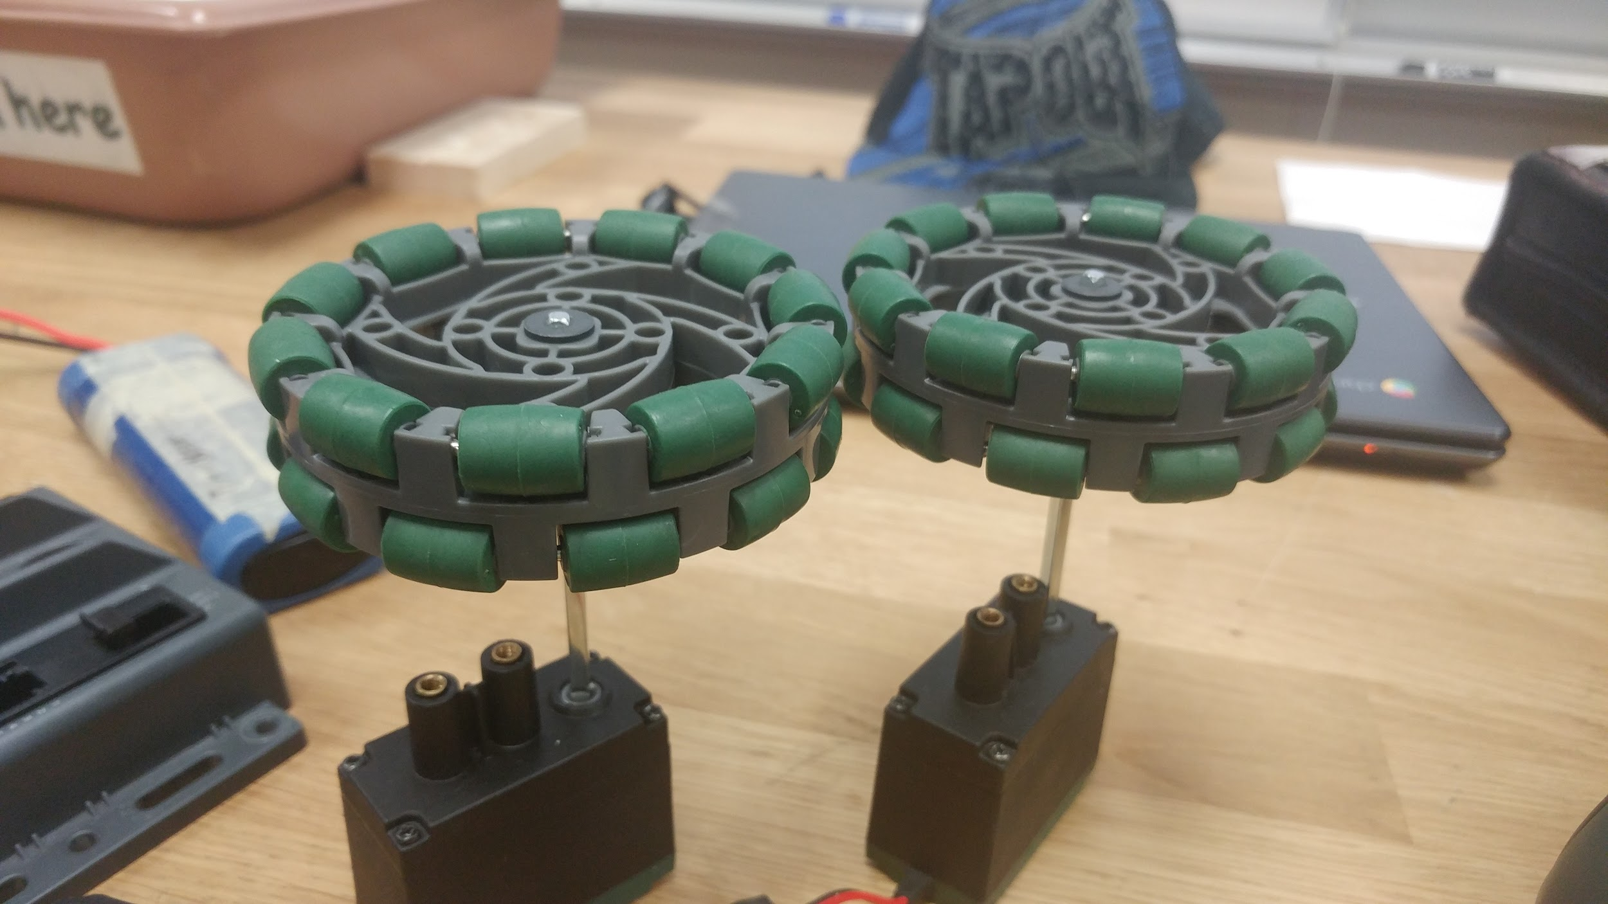
Step 3:
Place the wheels on the top of the shafts. Adjust the position of the collar so that the shafts fully go through the wheels.

Slide 5
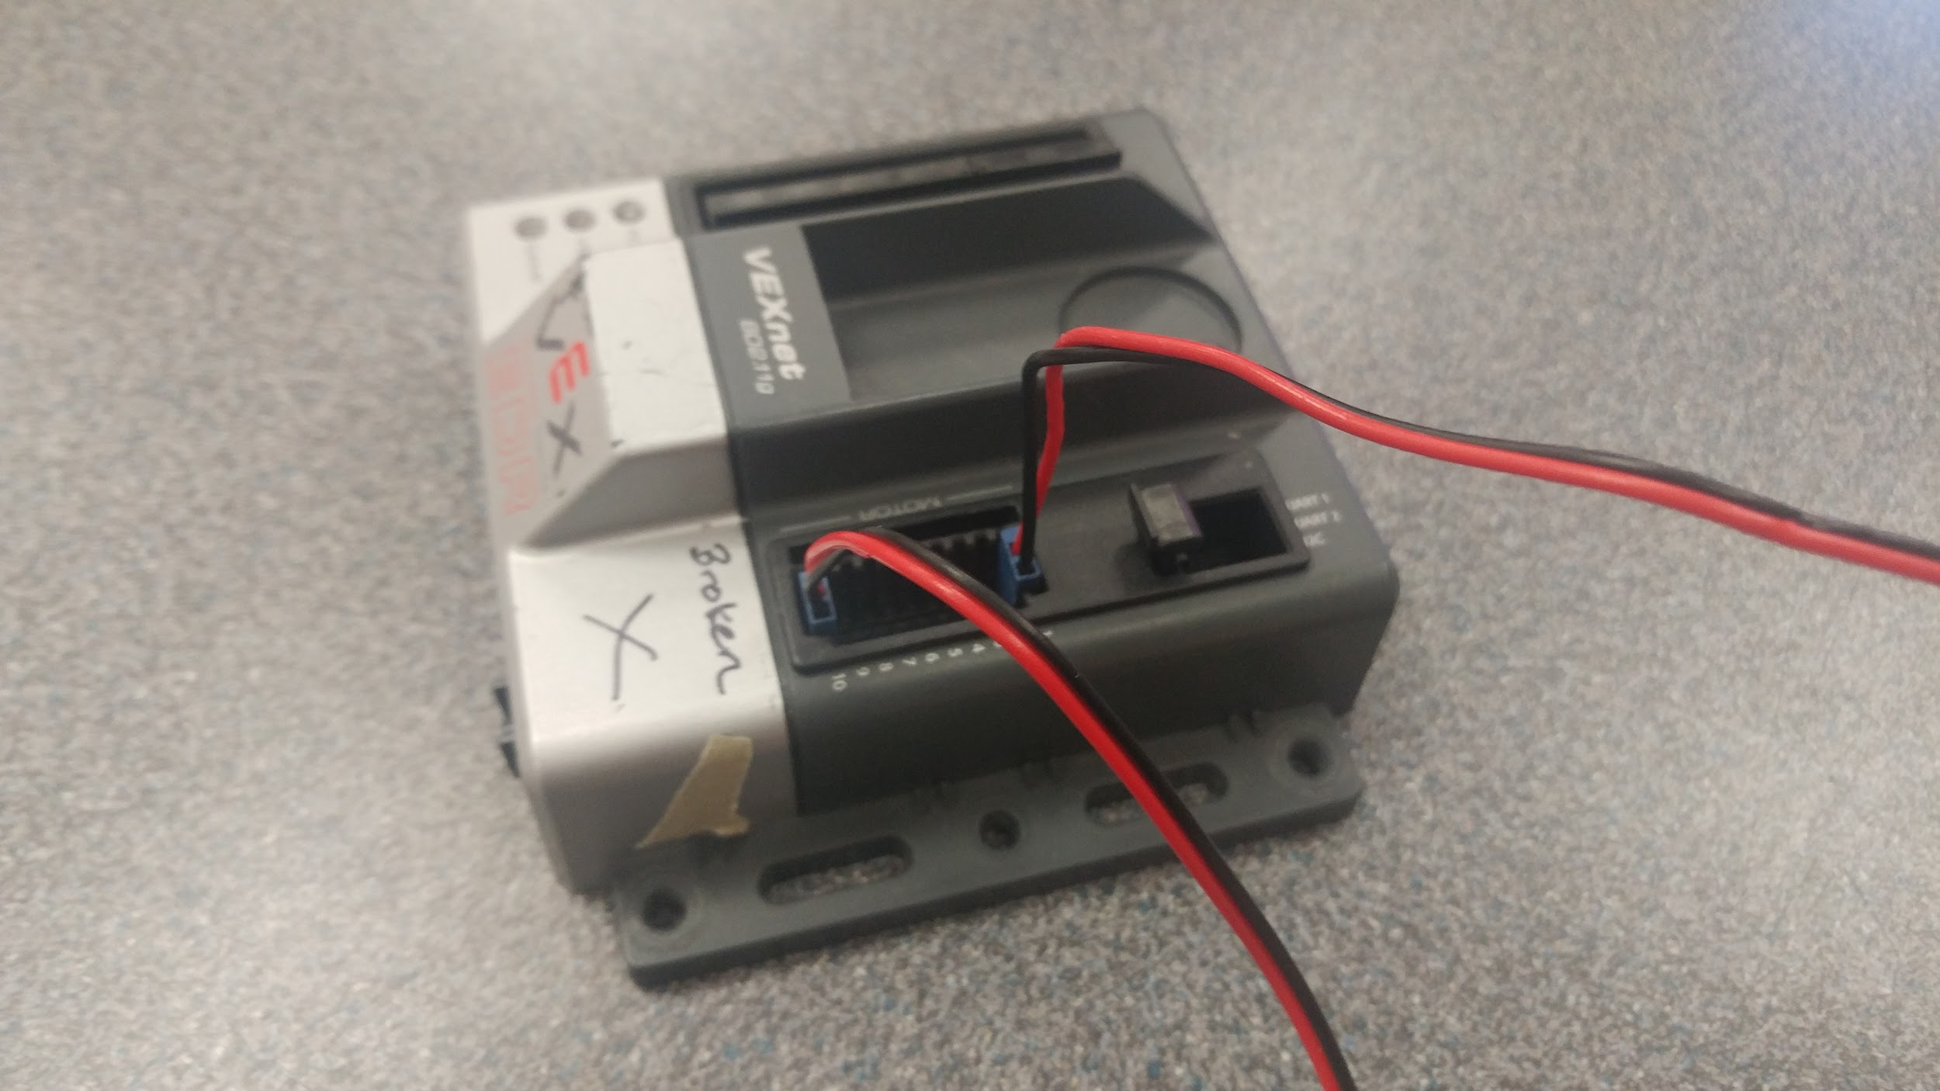
Step 4:
Plug the two pin motors in motor ports 1 & 10. Make sure the black wire is on the outside.

Slide 6
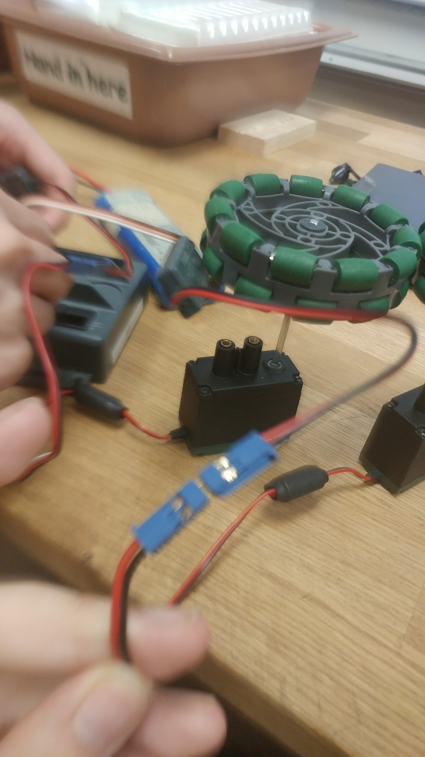
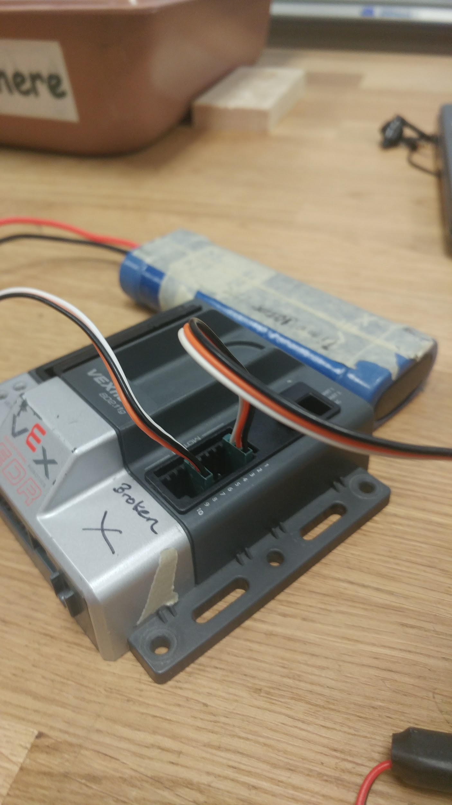
Step 4*:
If you want to plug the motors into ports 2 - 9, you will need a motor controller that converts 2 pin into 3 pin.
Make sure the motor controller is plugged in so that its black wire goes into the black wire of the motor.
Then plug the motor controller into motor ports 2 - 9 of the cortex. Again, the black wire should face outward.

Slide 7
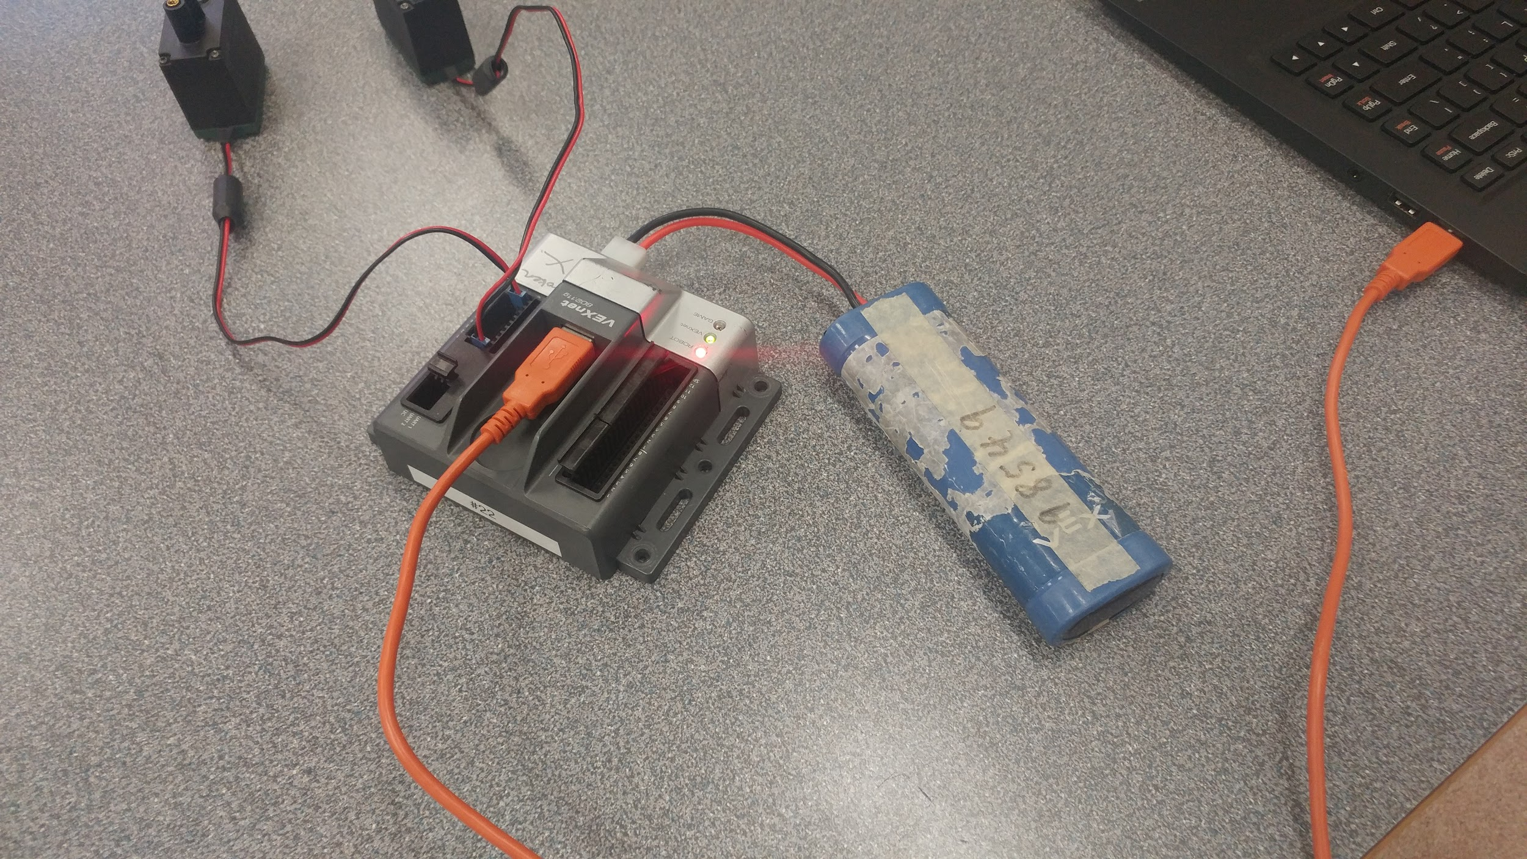
Step 5:
Plug in the battery. Connect the cortex to a laptop with an orange A-to-A cable.
Now the test kit is ready to be programmed!

Slide 8
Programming the Test Kit
-- Setting Up

Slide 9
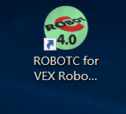
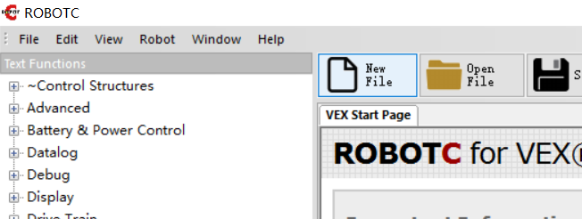
Double click on the ROBOTC icon.
Click on “New File” in the top toolbar (or use the shortcut “ctrl-n”).
On the top-left corner, click on “file -> save as”, and save it at a proper location with a filename including the names of your group members.

Slide 10
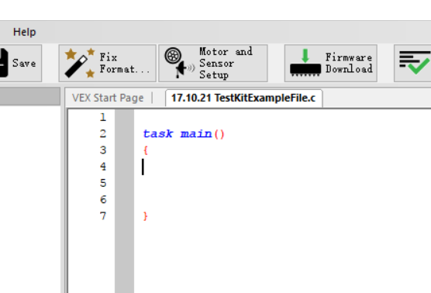
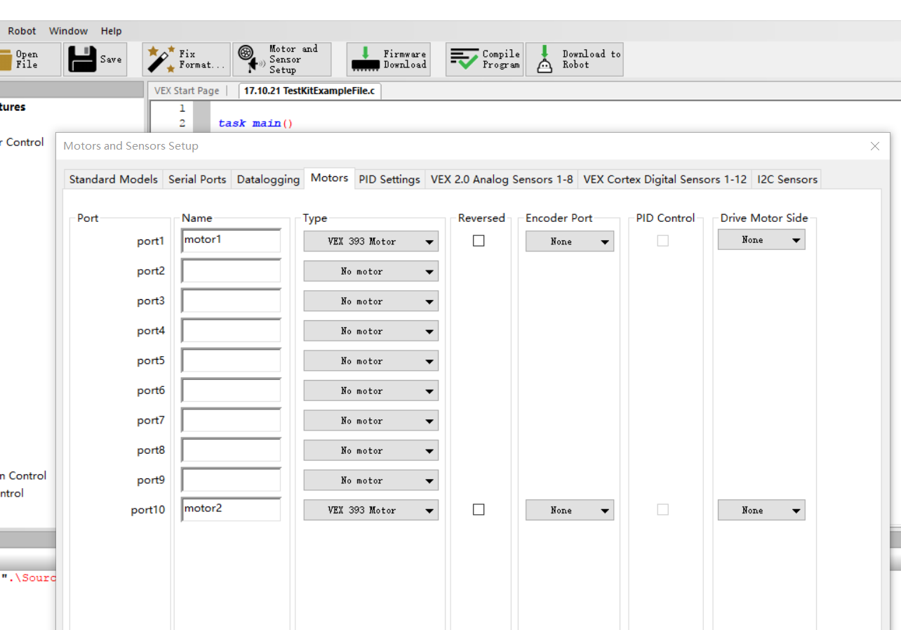
4. Select “Motor and Sensor Setup” on the top toolbar. The window below should pop up.
5. Go under the “motor” tab. Set the type to “VEX 393 Motor” in the ports where your motors are plugged into, and then name the motors. Types and names can be different for every robot.
Hit “enter” to save your motor set up.

Slide 11
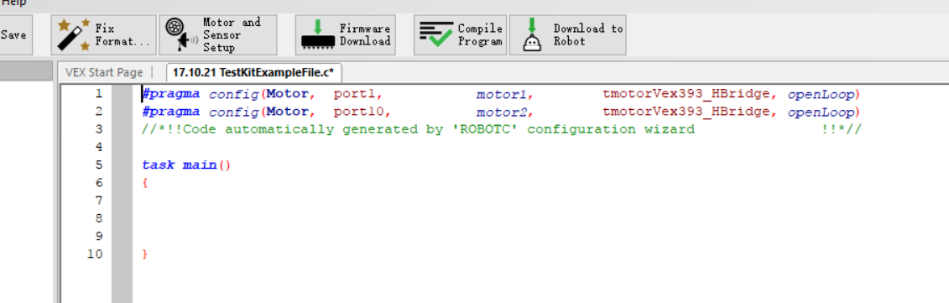
6. There should be similar kind of system generated statements as above. These are called pragma statements. Please do not change anything, not even the symbols or brackets or spacing. Changing the pragma statements may break your entire code.

Slide 12
Programming the Test Kit
-- Basic Movement

Slide 13
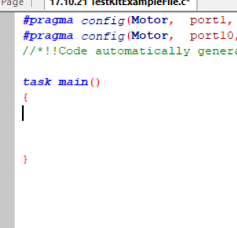
The basic logic of programming in ROBOTC is by telling the robot:
What it is doing
For how much time
A common mistake in the beginning stages is to only tell the robot what to do, but not giving it a timeframe.
Keeping that in mind, we can start by clicking in between the two brackets under “task main ()”.
Task main is, as the name suggests, the main task of the robot, a.k.a. what it is running when it turns on. The two brackets {} shows where this task starts and ends.

Slide 14
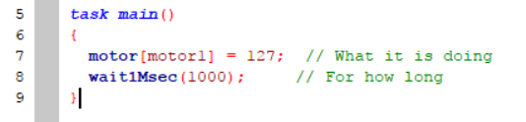
So here are the two basic commands to the robot. Coding is essentially translating human language to the robot’s language. So we want the robot to:
Run motor1 at full power.
Do that for 1 second.
Now we translate that into robot language:

Slide 15
1. motor[motor1] = 127;
[motor1] specifies which motor. Whenever we are picking which motor, or sensor, or button on the joystick to use, we put its name inside square brackets [] to indicate the selection
Equal sign = in code means to assign whatever value is on the right (127) to the items on its left, motor[motor1].
127 is the maximum power of the robot clockwise. -127 is the maximum power counterclockwise. 0 means no power is given, hence stopping.
Semicolon ; is used at the end of every statement you give, like the period to a sentence. However, they don’t show up after brackets {}.
This statement basically says: Set the motor named [motor1] to a power of 127.

Slide 16
2. wait1Msec(1000);
wait1Msec() is a built-in command to tell the robot “for how long”. The unit is millisecond.
(1000) specifies the amount of time. 1000 millisecond is one second.
Note that wait1Msec() doesn’t mean doing nothing, but instead it gives the timeframe in which any previous statements about “what it is doing” will run.
Semicolon ; is used at the end of every statement.
This statement basically says: Do the previous action for 1000 milliseconds (or 1 second). Or it can mean: wait 1000 milliseconds (1 second) before continuing to the next statement.

Slide 17
You may have noticed the green words // What it is doing
Double slashes // means to comment in ROBOTC. Any words after // in that line will show up green, and have no actual effect.
It is a good habit to comment on the code so you and your teammates know what is happening.

Slide 18
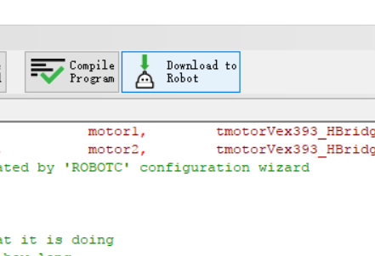
To download this code onto your test kit:
Make sure your cortex is on and connected to your laptop.
Click on “Download to Robot”.
Click “start” in the debugger window.
One of your wheels should turn for 1 second.

Slide 19
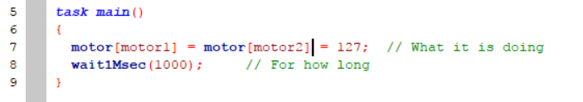
To get the second wheel moving as well, simply add another = motor[motor2] in your “what it is doing statement”.
You may have noticed spaces here and there. ROBOTC doesn’t read whitespace. That means, it doesn’t make a difference how your space things out, indent, or even change lines. That is also why the semicolon; is super important -- it is the only way for the robot to know which line is next.
However, even though whitespace doesn’t matter, it helps keep the code clean and easy to read.

Slide 20
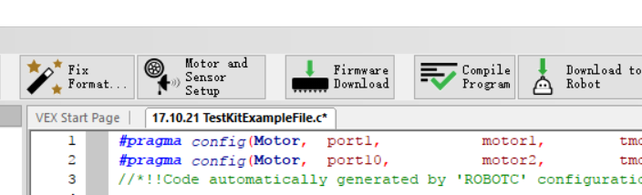
If your test kit doesn’t work at all, the most likely case is that the cortex needs a firmware update. To do that, turn your cortex off, and click on “Firmware Download” in the toolbar.
After the firmware update, turn your cortex on and try to download the code again.

Slide 21
Hope you enjoyed the first few lines of code!!
This powerpoint does contain a lot of over-explaining, but those knowledge will prove useful later. If there are any mistakes please let me know, and let’s improve together! :D
For questions or advice, please email alicexxx0516@gmail.com.
Alice X.
2018.03.28

